Slide 1
Introduction to NFV
Shamik Mishra

Slide 2
Agenda
Introduction to NFV
What is NFV
Why Virtualize
ETSI NFV Framework
NFV Infrastructure Domain
Compute Domain
Hypervisor Domain
Networking
NFV Management and Network Orchestration

Slide 3







What is Network Function Virtualization (NFV)
Today
Future
Separate Network appliance for each Function
Each Function Virtualized and Hosted on Commodity HW
Router
IMS
Firewall
GW
Load
Balancer
MME
Distribution
Switch
Radio
Nodes
Web
Servers
Network Functions hosted on Commodity Hardware through Virtualization
Scalable, Elastic and efficient usage of resources
Possibility of unified management and orchestration of services
Easy to introduce new functions => fast
Cost Effective
Promotes Open Innovation (is it so?)
Dedicated or Proprietary Hardware for each function
Unused computing capability => Less agility
Separate Management Systems
Difficult to introduce new services rapidly => Less Agility
Higher Power Consumption, Real-estate => High Capex

Slide 4
Why Virtualize?
When a resource is too big for a single user, it is best to divide it into multiple virtual pieces
Each function can run on multiple VMs and each machine can be used by different users.
The same applies to high-speed links and large-capacity disks
Virtual devices are easier to manage because they are software-based and expose a uniform interface through standard abstractions.
Management
Sharing
Multiple users may not trust users, it is important to isolate users
Provider should be able to share resources but easily isolate the data
Reduce CAPEX through less investment in energy, Real-estate and dedicated hardware
Cost Reduction
Isolation
Dynamics
If computing capability is unused, it can be re-used for other network functions dynamically
Rapidly scale-up / scale down services as required
Optimize resources at real-time
Aggregation
If the resource is too small, it is possible to construct a large virtual resource that behaves like a large resource and allocate resources to large number of appliances

Slide 5
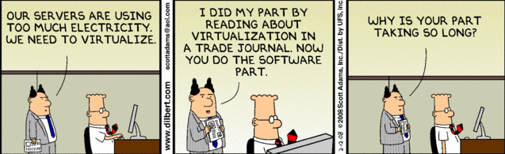
NFV: Beyond Virtualization
Virtualization is an excellent way to cut expenses but it is equally challenging to manage and automate the virtualization environment

Slide 6
NFV Framework
OSS / BSS
Os-Ma-nfvo
NFV Orchestrator (NFVO)
NFV MANAGEMENT AND NETWORK ORCHESTRATION (MANO)
Service, VNF and
Infrastructure Description
EMS
EMS
EMS
Or-Vnfm
VNFs
Ve-Vnfm
VNF Manager (VNFM)
VNF
VNF
VNF
Vn-Nf
NFVI
Vi-Vnfm
Or-Vi
Virtual Computing
Virtual Storage
Virtual Network
Virtual Infrastructure Manager (VIM)
Nf-Vi
Virtualization Layer
VI-Ha
Computing Hardware
Storage Hardware
Network Hardware
NFV Reference Points
Execution Reference Points

Slide 7
NFV Infrastructure Domains
OSS / BSS
Os-Ma-nfvo
NFV Orchestrator (NFVO)
Se-Ma
NFV MANAGEMENT AND NETWORK ORCHESTRATION (MANO)
Service, VNF and
Infrastructure Description
EMS
EMS
EMS
VNFs
Ve-Vnfm
VNF Manager (VNFM)
VNF
VNF
VNF
Vn-Nf
NFVI
Hypervisor Domain
Virtual Computing
Virtual Storage
Virtual Network
Virtual Infrastructure Manager (VIM)
Nf-Vi
Virtualization Layer
VI-Ha
Computing Hardware
Storage Hardware
Network Hardware
Compute
Domain
Infrastructure Network
Domain

Slide 8
NFVI
Compute Domain
Separated CPU, Storage and NIC / Accelerators. Blades interconnected over Optical fibre.
Separating critical components from independently
Compute Domain should support multiple virtual appliance. Simple words: able to virtualize
VM
VM
VM
VM
VM
Physical Interfaces
Ethernet
Nf-Vi
VIM
Possibility of Dis-aggregation
Fiber Channel
CPU Blades
NIC / Accelerators
Storage Blades
External Interfaces
Infiniband
Processor & Accelerator
Network Interfaces
Storage
Compute Architecture: x86 & ARM. Does not prevent other architectures
Accelerators: Security, Networking, Packet Processing
Network Capability Resident in Server (NIC connects to the processor via PCIe)
NIC may contain offload or acceleration functionality
Large Scale Storage, Non-Volatile storage (hard disks, solid state devices)

Slide 9
NFVI
Hypervisor Domain
VNF
VNF
Hypervisor Domain
High Availability
CPU Scheduler
vCPU
Guest OS
Live Migration
Memory Manager
vMem
vNIC
Nf-Vi
VIM
Physical NIC Driver
Management Agent
HBA Driver
vHBA
vDisk
Virtual Machine Management APIs
External Interfaces
Virtual Switch
Virtual Machine
Hypervisor Management
Vi-Ha
Storage
NIC
Core
Core
Core
Core
Compute Node

Slide 10
End to End Network Service
VNF Forwarding Graph
End to End Network Service
Forwarding
Graph-1
NF2
NF4
NF1
NF5
B
A
NF3
Forwarding
Graph-2
Virtualization Layer
Hardware Resources in
Physical Location
Physical Link
Logical Link
Virtualization

Slide 11
Management and Network Orchestration
Concepts
Functional Blocks
Orchestrator:
– on-boarding of new Network Service (NS), VNF-Forwarding Graph and VNF Packages
– NS lifecycle management (including instantiation, scale-out/in, performance measurements, event correlation, termination)
– global resource management, validation and authorization of NFVI
resource requests
– policy management for NS instances
OSS / BSS
Os-Ma
NFV Orchestrator (NFVO)
NFV MANAGEMENT AND NETWORK ORCHESTRATION (MANO)
Service Description
Se-Ma
VNFs
Ve-Vnfm
VNF Manager (VNFM)
VNF Manager:
– lifecycle management of VNF instances
– overall coordination and adaptation role for configuration and event
reporting between NFVI and the E/NMS
Virtualized Infrastructure Manager (VIM):
– controlling and managing the NFVI compute, storage and network
resources, within one operator’s infrastructure sub-domain
– collection and forwarding of performance measurements and events
Virtual Infrastructure Manager (VIM)
NFVI
Nf-Vi

Slide 12

VNF Forwarding Graph
NF2
NF3
B
Orchestration
NF1
Net2
A
Net1
OSS
Service Instantiation
NFV MANO
NFV Orchestration
Automated
Automated
Automated
B
A
Switch
Automated
Automated
Automated
NF1
NF2
NF3
Virtualized
Configuration

Slide 13
Network Service Lifecycle Management
Simple Example
Network Service
VNF Packages
NFV Orchestrator (NFVO)
OSS / BSS
Network Service Instantiate
Resource Allocation, Management, Optimization, Authorization
Network Service
Monitoring
EMS
EMS Instantiation
VNF Manager (VNFM)
VNFs
VNF Instantiation
VNF Health Monitoring
NFVI Resource Reservation
Allocate / Update
VM Resources
Network Resources
Virtual Infrastructure Manager (VIM)
NFVI

Slide 14
Management & Orchestration
Operations
Network Service Management
Virtualized Resource Management
1
2
3
4
NFVI Management
Network Service lifecycle management / Change Notification
Network Service performance management
Network Service fault management
Ex: Instantiate, Terminate, Query, Scale E2E Network Services
VNF Management
catalogue management
capacity management
Resource management
Performance management
Fault Management
Hypervisor management (Ex: create, suspend, delete, reboot, restore VMs)
Create, delete, list network, subnet, ports etc.
VNF Package management
VNF software image management
VNF lifecycle operation granting
VNF lifecycle management / Change Notification
VNF configuration
VNF performance management
VNF fault management

Slide 15

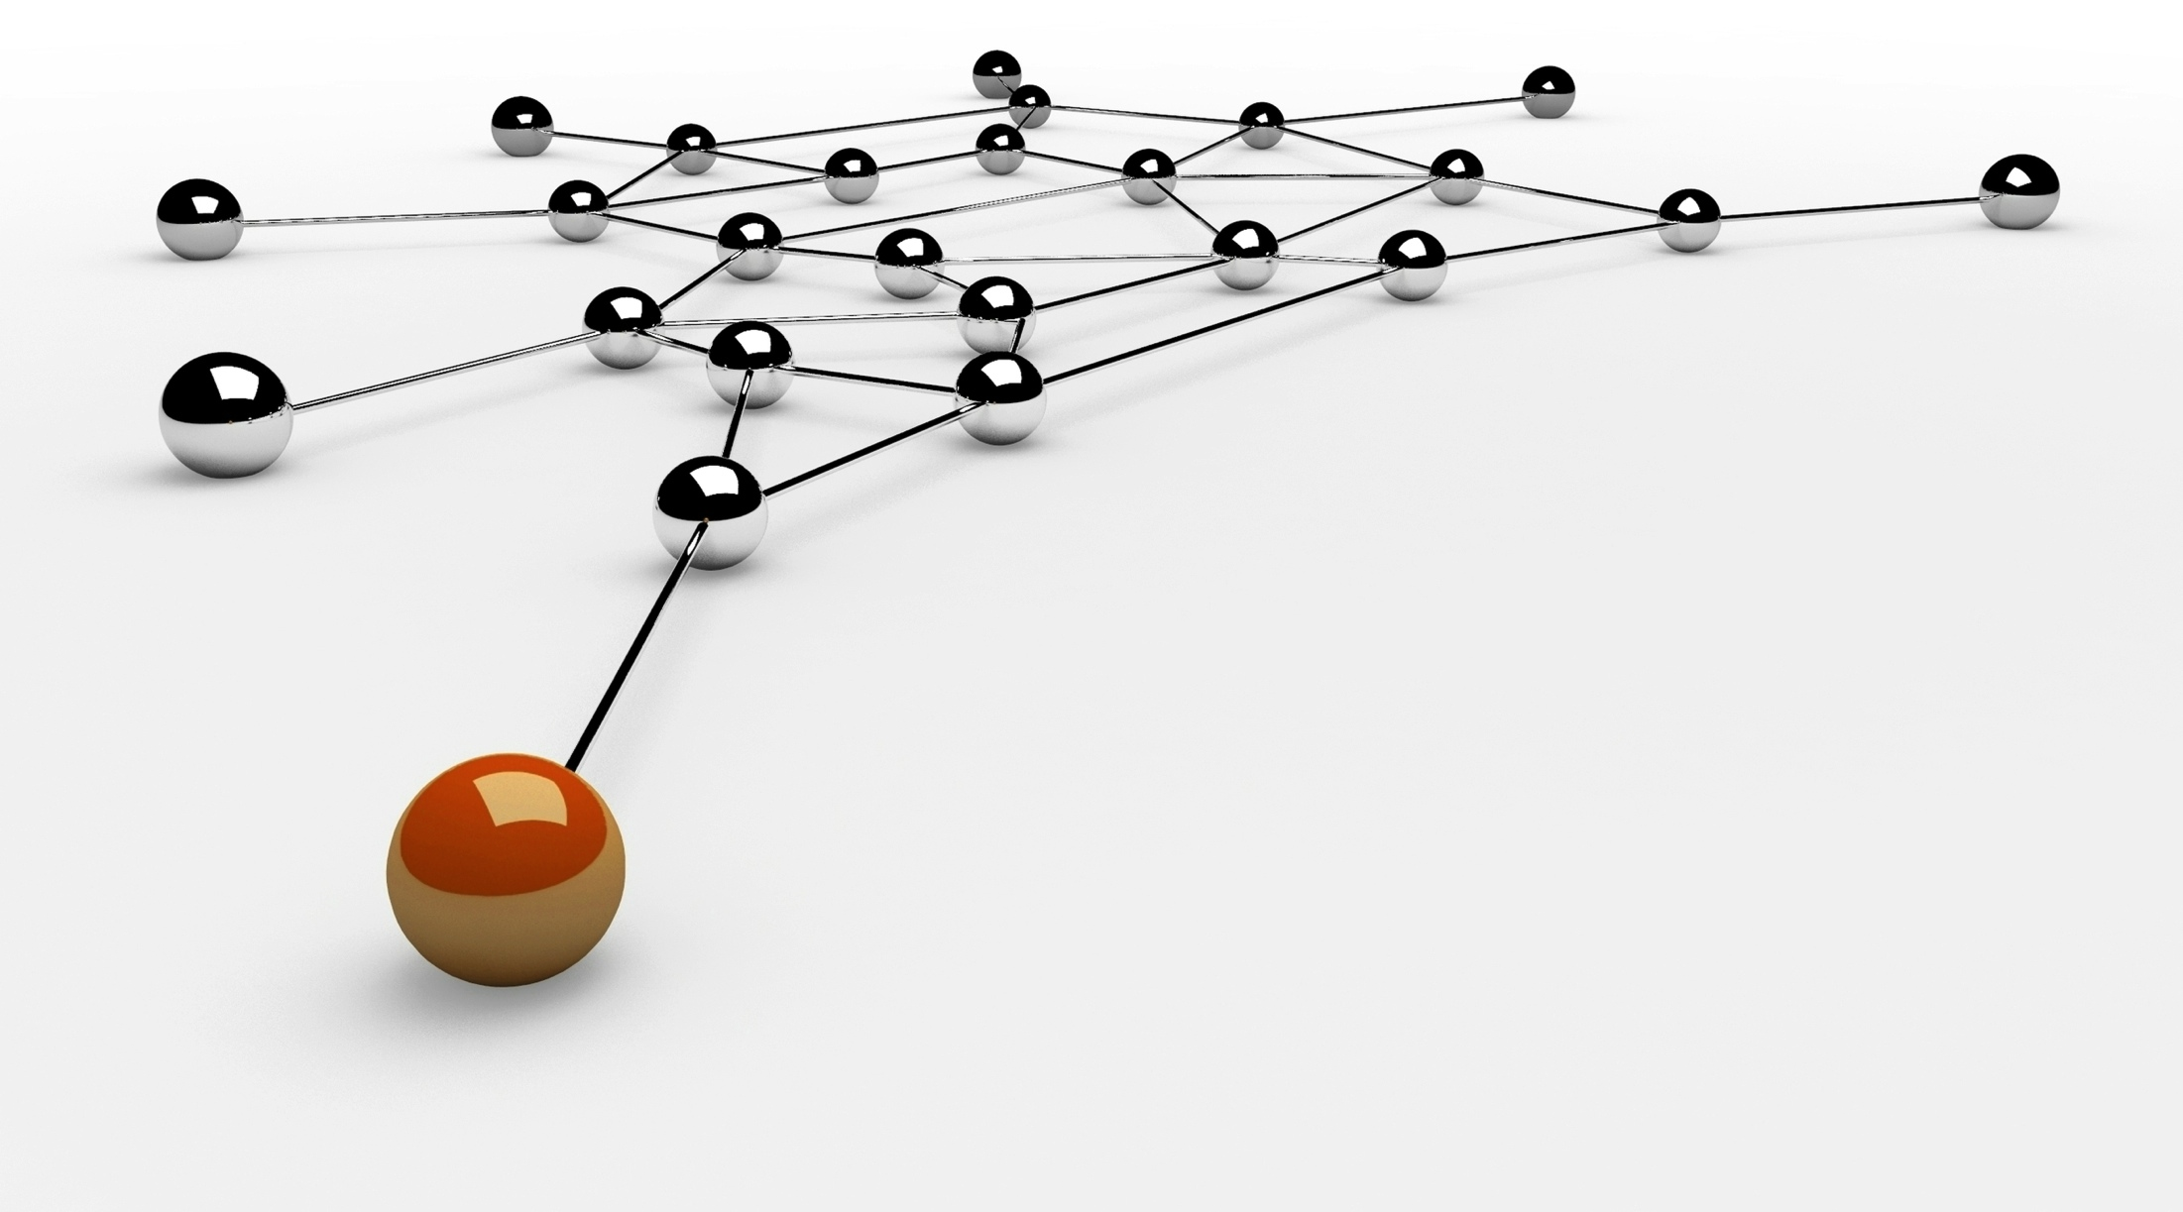
Thank you.
Headquarters
303 Twin Dolphin Drive 6th Floor Redwood City, CA 94065 USA
Tel: +1 650 632 4310 Fax: +1 650 551 9901
APAC HQ
Plot 31, Electronic City Sector 18 Gurgaon, Haryana 122015 India
Tel: +91 124 4095888 Fax: +91 124 2455100
Europe HQ
Intec 4, Wade Road, Basingstoke, Hampshire RG24 8NE, United Kingdom
Tel: +44 1256 339500

